Slide 1


Low-temperature solution processing of metal oxide interlayers for OPVs and OLEDs
M. Morbidoni
maurizio.morbidoni13@imperial.ac.uk
Department of Materials & Centre for Plastic Electronics, Imperial College London

Slide 2
Outline
Introduction
Molybdenum Oxide
Scope
Characterisation (Compositional and Optical)
Devices (OPVs, OLEDs, Injection)
Conclusions
PEDOT:PSS/MoOx blend
Scope
Characterisation (Compositional, Optical, Morphological)
Devices (OPVs, OLEDs, Injection)
Conclusions

Slide 3
Wider Context
Vacuum
3.0 eV
3.7 eV
4.0 eV
PEDOT:PSS
MoOx
VOx
WOx
NiOx
CuOx
P3HT
4.2 eV
ICBA
Electron
ZnO
Energy
Ag
ITO
Hole
5.0 eV
5.8 eV
7.3 eV
hν
P3HT: poly(3-hexylthiophene-2,5-diyl)
ICBA: indene-C₆₀ bisadduct
Zhang J et al., http://doi.wiley.com/10.1002/aelm.201600008

Slide 4
Wider Context
Arguably, the most common anode interlayer is PEDOT:PSS. However, its acidic and hygroscopic nature is detrimental to device lifetime and stability.
These issues can be overcome by using
transition metal oxides as interlayers.
Transition metal oxides make great interlayers because:
They are transparent
(because of their wide band gap);
They cover a wide range of
work function values;
They are usually stable
when incorporated in a device.

Slide 5
Energy Level Alignment
Adapted from Greiner et al, NPG Asia Materials (2013) 5, e55; doi:10.1038/am.2013.29

Slide 6
Energy Level Alignment

Slide 7
Outline
Introduction
Molybdenum Oxide
Scope
Characterisation (Compositional and Optical)
Devices (OPVs, OLEDs, Injection)
Conclusions
PEDOT:PSS/MoOx blend
Scope
Characterisation (Compositional, Optical, Morphological)
Devices (OPVs, OLEDs, Injection)
Conclusions

Slide 8
Scope
Solution-processed metal oxides (e.g. MoO_{3-x}) as PEDOT:PSS substitutes for anode interlayers.
Hydrogen bronze route:
simple precursor and simple additive
Mo or MoO₃ powder in an alcohol-H₂O₂ mixture
aging and oxidation of the precursor
the solvent system is evaporated
MoO_{3-x} re-dissolved in an alcohol, usually ethanol
Notes:
The hydrogen bronze synthesis is very good for MoO_{3-x} films and has the advantage of involving a simple precursor and a simple additive.

Slide 9
Scope
Mo or MoO₃ powder in an alcohol-H₂O₂ mixture
aging and oxidation of the precursor
the solvent system is evaporated
MoO_{3-x} re-dissolved in an alcohol, usually ethanol
Evaporation step is challenging, cumbersome and honestly quite a waste of time.
I found it difficult to obtain reproducible results using the ‘standard’ procedure.
So I decided to remove the evaporation step and instead deposit the films directly from the alcohol-H₂O₂ solvent system.

Slide 10
Scope
9 different solvo-thermal processing conditions:
Methanol | Vacuum-assisted solvent removal
 | 75 °C
 | 150 °C
Ethanol | Vacuum-assisted solvent removal
 | 75 °C
 | 150 °C
Isopropanol | Vacuum-assisted solvent removal
 | 75 °C
 | 150 °C
I wanted to keep the post-deposition temperature low enough for the route to be compatible with plastic substrates and inverted device architectures, so I decided to employ three different 10-minutes post-deposition treatments: ‘vacuum annealing’, 75 °C or 150 °C.
I also started wondering what solvent would be best.
Almost everybody uses ethanol;
someone 2-methoxyethanol, but that is a bit nasty.
Almost nobody had looked at the effects of different solvents on the MoO_{3-x} films.
I therefore decided to try three (not-so-different) solvents and see what happened: the choices were methanol, ethanol and isopropanol.

Slide 11
Experimental
The MoO_{3-x} films are inserted in OPV and OLED devices, in a standard architecture.
A Ca/Ag (20/100 nm) cathode is thermally evaporated on top of the device.
The active layer is deposited on the anode bilayer:
For OPV, a P3HT:ICBA blend (100 nm)
For OLED, green PPV (70 nm)
I used devices as a routine characterisation tool, to avoid time-consuming studies on the slight effects of all the different parameters on the material properties. They were in fact the only instance when ALL the nine parameters were analysed.
All the other characterisation experiments were thought out carefully to minimise the number of samples. A sort of ‘Design of Experiments for Dummies’.

Slide 12
XPS
From Mo⁶⁺/Mo⁵⁺ ratio: MoO_{2.7}

Slide 13
Optical Properties

Slide 14
OPV
Sample |  | V_{oc} (V) | J_{sc} (mA/cm²) | FF | PCE (%)
Solvent | Treatment
PEDOT:PSS Reference |  | 0.73 | -8.16 | 0.58 | 3.41
Methanol | V. A. S. R. | 0.80 | -8.51 | 0.57 | 3.91
 | 75 °C | 0.79 | -8.31 | 0.58 | 3.83
 | 150 °C | 0.76 | -7.90 | 0.58 | 3.50
Ethanol | V. A. S. R. | 0.79 | -7.66 | 0.49 | 2.97
 | 75 °C | 0.80 | -8.15 | 0.53 | 3.47
 | 150 °C | 0.79 | -8.19 | 0.58 | 3.79
Isopropanol | 150 °C | 0.72 | -7.33 | 0.55 | 2.91
Sample |  | Measured parameter
Solvent | Treatment | R_{sh} (kΩ, +/- 1) | R_{s} (Ω, +/- 10)
PEDOT:PSS Reference |  | 17 | 380
Methanol | V.A.S.R. | 21 | 390
 | 75 °C | 23 | 350
 | 150 °C | 19 | 350
Ethanol | V.A.S.R. | 13 | 640
 | 75 °C | 19 | 520
 | 150 °C | 21 | 380
Isopropanol | 150 °C | 15 | 430

Slide 15
AFM
Unfavourable morphology

Slide 16
XPS on blend
Mo3d
MoO_{3-x}
S2s
I
T
O
P3HT over MoO_{3-x}
MoO
3
-
P3H
x
T
:IC
B
A
70 nm
b.
If MoOx is annealed at T<150 °C, the active layer solution dissolves it.

Slide 17
OLED
Sample |  | Max CE (cd/A) | V at max CE (V) | PE at max CE (lm/W) | L at max CE (cd/m²) | J at max CE (mA/cm²)
Solvent | Treatment
PEDOT:PSS Reference |  | 5.57 | 6.2 | 2.80 | 1210 | 21.95
Methanol | V. A. S. R. | 5.41 | 5.2 | 3.28 | 1299 | 24.12
 | 75 °C | 6.39 | 5.8 | 3.46 | 1624 | 25.39
 | 150 °C | 5.34 | 5.2 | 3.23 | 1314 | 24.56
Ethanol | V. A. S. R. | 5.48 | 5.7 | 3.04 | 1160 | 45.78
 | 75 °C | 6.06 | 5.7 | 3.32 | 1431 | 23.55
 | 150 °C | 5.03 | 4.9 | 3.25 | 1379 | 27.50
Isopropanol | V. A. S. R. | 3.44 | 7.2 | 1.52 | 1666 | 48.55
 | 75 °C | 5.80 | 6.2 | 2.94 | 1469 | 25.35
 | 150 °C | 4.55 | 5.2 | 2.75 | 1340 | 29.59

Slide 18
Charge Injection

Slide 19
EQE
5% increase in J_{sc} over PEDOT:PSS

Slide 20
Conclusions
N-type metal oxides such as MoO_{3-x} can substitute PEDOT:PSS in organic optoelectronic devices
Solvo-thermal processing conditions have a
major effect in these materials’ performances in devices
A few different sets of conditions result in devices outperforming the reference, hinting at the possibility of a bespoke recipe that could fit many different requirements on device processing and choice of substrates.
Notes:
Stress the fact that all possible parameters in sol-gel synthesis of metal oxides provide a vast choice of conditions that can be tailored to the device and its processing as well as its use.
Next step, mention that you get same trend with green ppv derivative in PLEDs.

Slide 21
Outline
Introduction
Molybdenum Oxide
Scope
Characterisation (Compositional and Optical)
Devices (OPVs, OLEDs, Injection)
Conclusions
PEDOT:PSS/MoOx blend
Scope
Characterisation (Compositional, Optical, Morphological)
Devices (OPVs, OLEDs, Injection)
Conclusions

Slide 22
Introduction
Organic electronics enables the fabrication of flexible devices
As seen before, the issues presented by PEDOT:PSS can be overcome by using
transition metal oxides as interlayers.
However, they must be very thin, which could prove detrimental when dealing with rough or flexible substrates, a problem that PEDOT:PSS does not have.
Notes:
Organic electronics enables fabrication of flexible devices. Standard architecture devices like the one in the picture have the anode interlayer underneath the active layer. PEDOT:PSS, the most common HTL, is acidic, which affects the ITO, and hygroscopic, which affects the active layer. These factors limit lifetime and stability of devices.
The use of TMOs provides a solution to this, but they come with problems of their own. In particular, they need to be very thin (<15 nm), which could be a problem with rough/flexible substrates. PEDOT:PSS, on the other hand, is usually deposited with thicknesses ~50 nm.

Slide 23
The best of both worlds
It has been shown that the lifetime of devices incorporating a PEDOT:PSS interlayer can be increased if this is blended with MoO₃. Other benefits on device performance were observed from the use of a PEDOT:PSS/MoO₃ blend.
The variation of the hydrogen bronze route (metal+alcohol+H₂O₂) presented before is
suitable for use in a similar approach
The precursor solutions of PEDOT:PSS and MoO_{3-x} are mixed in different volume ratios:
2 parts of PEDOT:PSS solution / 1 part of MoO_{3-x} (sample A)
1 part of PEDOT:PSS solution / 1 part of MoO_{3-x} (sample B)
1 part of PEDOT:PSS solution / 2 parts of MoO_{3-x} (sample C)
S. Shao et al., Adv. Energy Mater., vol. 3, no. 3, pp. 349–355, Mar. 2013 | Y. Wang et al., ACS Appl. Mater. Interfaces, vol. 7, no. 13, pp. 7170–7179, Apr. 2015
Notes:
So, can we have our cake and eat it, can we combine the advantages of TMOs with those of PEDOT:PSS.
It has been shown that incorporating MoO3 into PEDOT:PSS increased the lifetime of organic devices when compared with standard PEDOT:PSS.
We recently developed a variation of the hydrogen bronze route (metal+alcohol+hydrogen peroxide) to synthesise substoichiometric MoOx. The alcoholic solvent makes it perfect to fabricate these hybrids by mixing the precursor solutions of PEDOT:PSS and MoOx.
Three volume ratios were explored: A, B, and C.

Slide 24
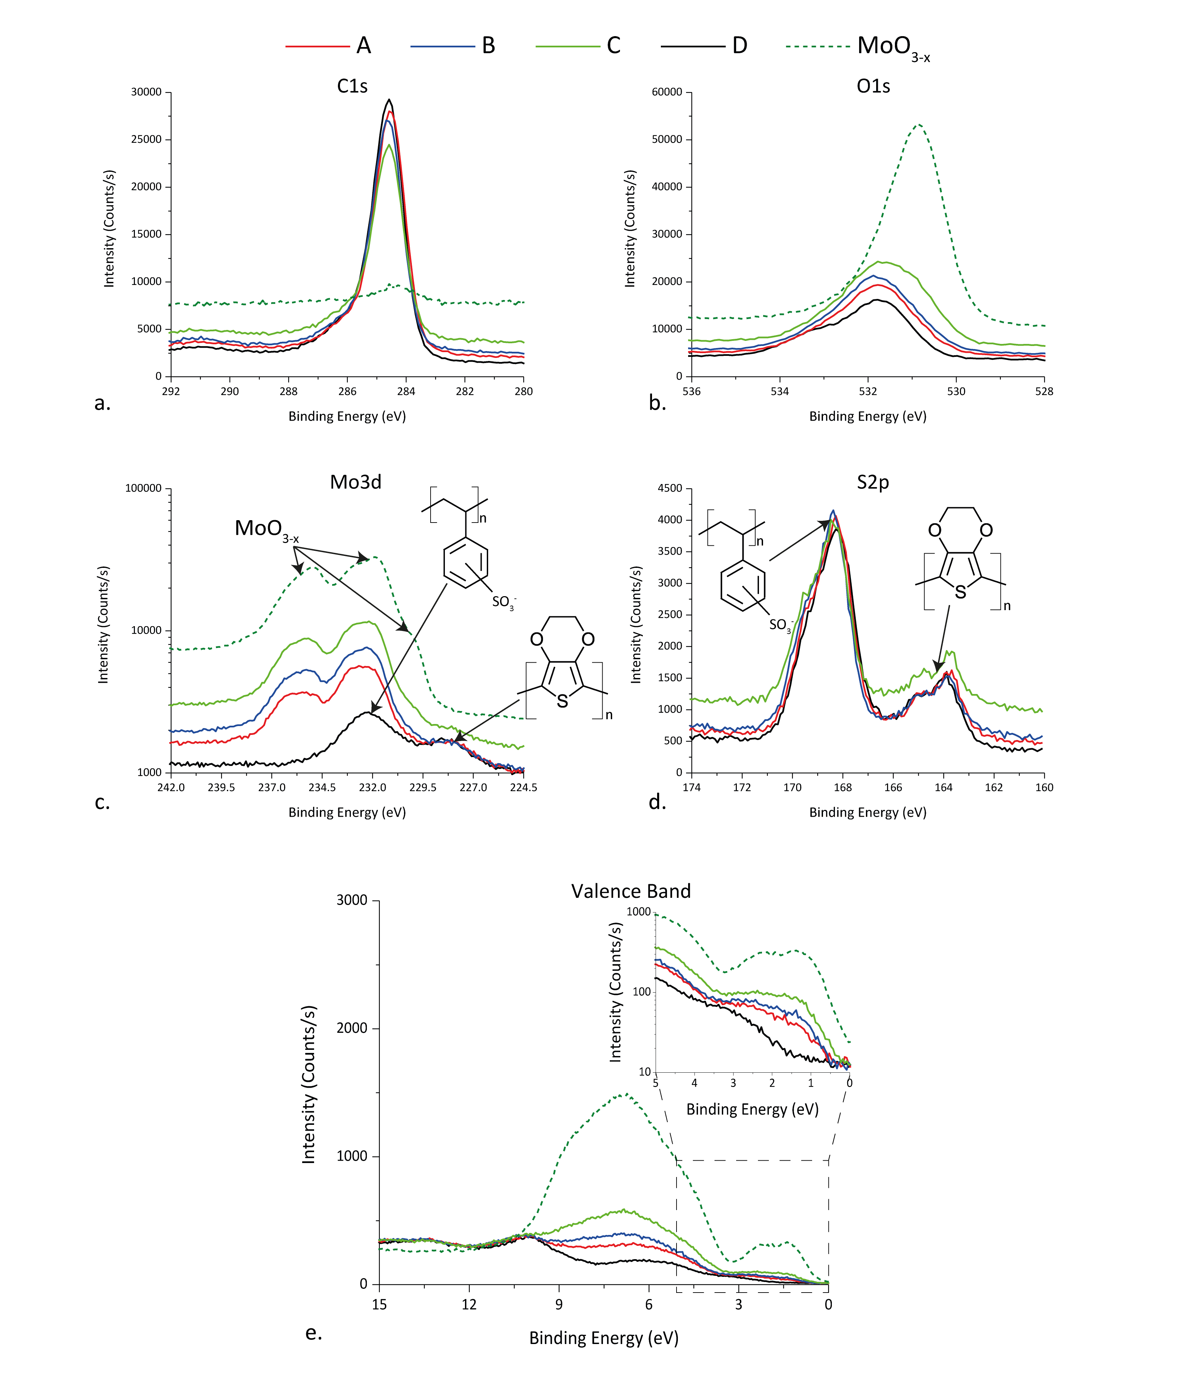
XPS
MoO_{3-x} is not bonded to either PEDOT or PSS
Partial occupation of Mo4d orbitals because of oxygen vacancies give rise to intragap states
Notes:
First, the composition of the hybrid films was analysed and compared with standard PEDOT:PSS and MoOx deposited from the same hydrogen bronze route, using XPS.
S2p signal was used because S2s overlaps with Mo3d.
C1s and S2p signals do not show any shift in binding energy, which means that MoOx is not bonding to either PEDOT or PSS, but is instead simply embedded in the organic matrix. Mo3d signal (bottom left) is the same in the hybrids and in the reference MoOx, again confirming that the materials are simply blended together.
The valence band spectra is analysed next, especially in the region close to the Fermi level. PEDOT:PSS tails off to zero intensity at about 1.5 eV above the Fermi level. On the other hand, partial occupancy of Mo4d orbitals (induced by oxygen vacancies) produces intragap states in MoOx films. These states are also observed in the hybrid, and may have beneficial effects on the behaviour of optoelectronic devices.

Slide 25
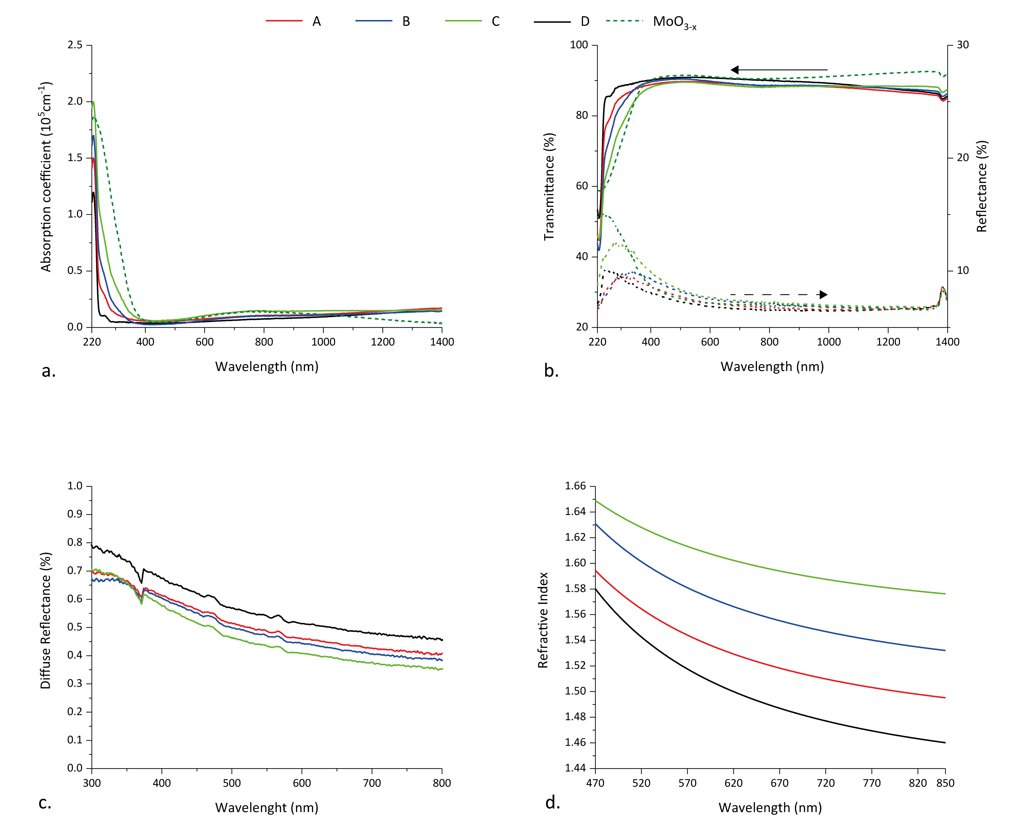
Optical Properties
Films are transparent in the visible range
there is a linear increase in the refractive index with increasing amounts of MoO_{3-x}
Thanks to Luca Occhi and
Dr Paul Stavrinou for the refractive index measurements
Notes:
Optical properties were analysed next, using UV-Vis spectroscopy. From the absorption coefficient, transmission and reflection data, it is clear that the hybrids are transparent in the visible range, at least as much as PEDOT:PSS alone. The incorporation of particles of a high-refractive index material such as MoOx may produce light scattering, but as seen in the diffuse reflectance data that is not the case, a first indication of the uniform dispersion of MoOx in the organic matrix. There is however one effect due to the high refractive index of MoOx, and that’s the change in the refractive index of the hybrid material, which increases linearly from the value of standard PEDOT:PSS with increasing loading of MoOx.

Slide 26
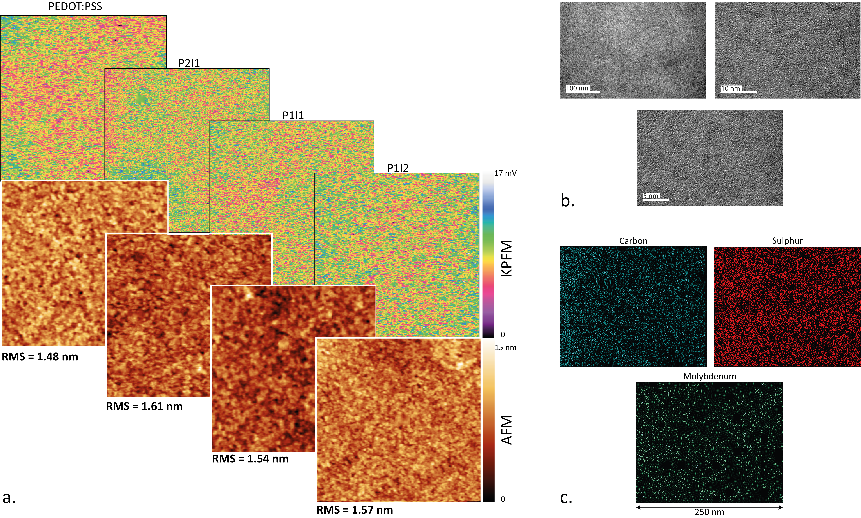
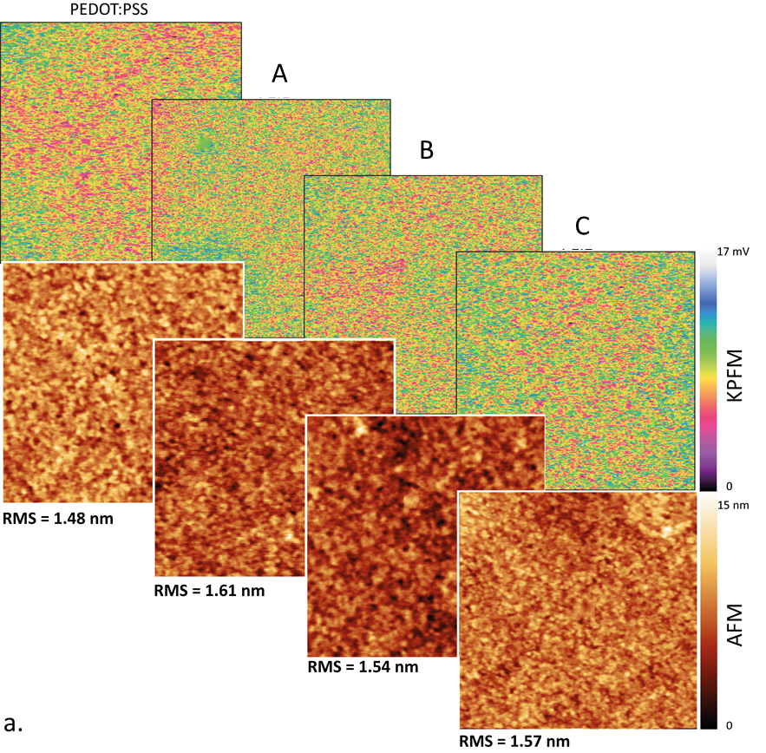
Morphology
Sample B
Thanks to Dr Claire Burgess for the TEM images and the EDX data.
Notes:
As suggested from the diffuse reflectance data, MoOx seems to be well-dispersed within the organic matrix. In earlier reports MoOx features protruding from the surface were observed. We performed AFM and KPFM to understand the morphology of the hybrids’ surface. In the top row, KPFM data is shown, which demonstrates that the surface of the samples is very uniform and there isn’t any surface segregation of MoOx. In AFM images, on the bottom row, no protruding features were observed, as opposed to previous reports; nevertheless, a small increase in roughness was observed, which was found to be beneficial for the wetting of the active layer solution.
Having excluded any surface segregation/agglomerates, we took TEM images of sample B to check that MoOx was well-dispersed throughout the hybrid. The images show no contrast at any length scale, so no dense MoOx agglomerates are present. Finally, to be 100% sure, EDX data was collected: signals from Mo, C, and S are spread fairly evenly throughout the area analysed, again confirming the excellent intermixing of MoOx and PEDOT:PSS.

Slide 27
Summary
A
B
C

Slide 28
Devices
The hybrids are inserted in OPV and OLED devices, in a standard architecture.
A Ca/Ag (20/100 nm) cathode is thermally evaporated on top of the device.
The active layer is deposited on top of the anode bilayer:
For OPV, a P3HT:ICBA blend (100 nm)
For OLED, green PPV (70 nm)
Notes:
Finally, devices were fabricated in a standard architecture, with a top cathode. A diagram is shown, together with a picture of a working LED fabricated using sample B; dimensions are shown as well.
The active layers used were a P3HT:ICBA blend for OPV and a green PPV for OLEDs, with a Ca/Ag cathode bilayer.

Slide 29
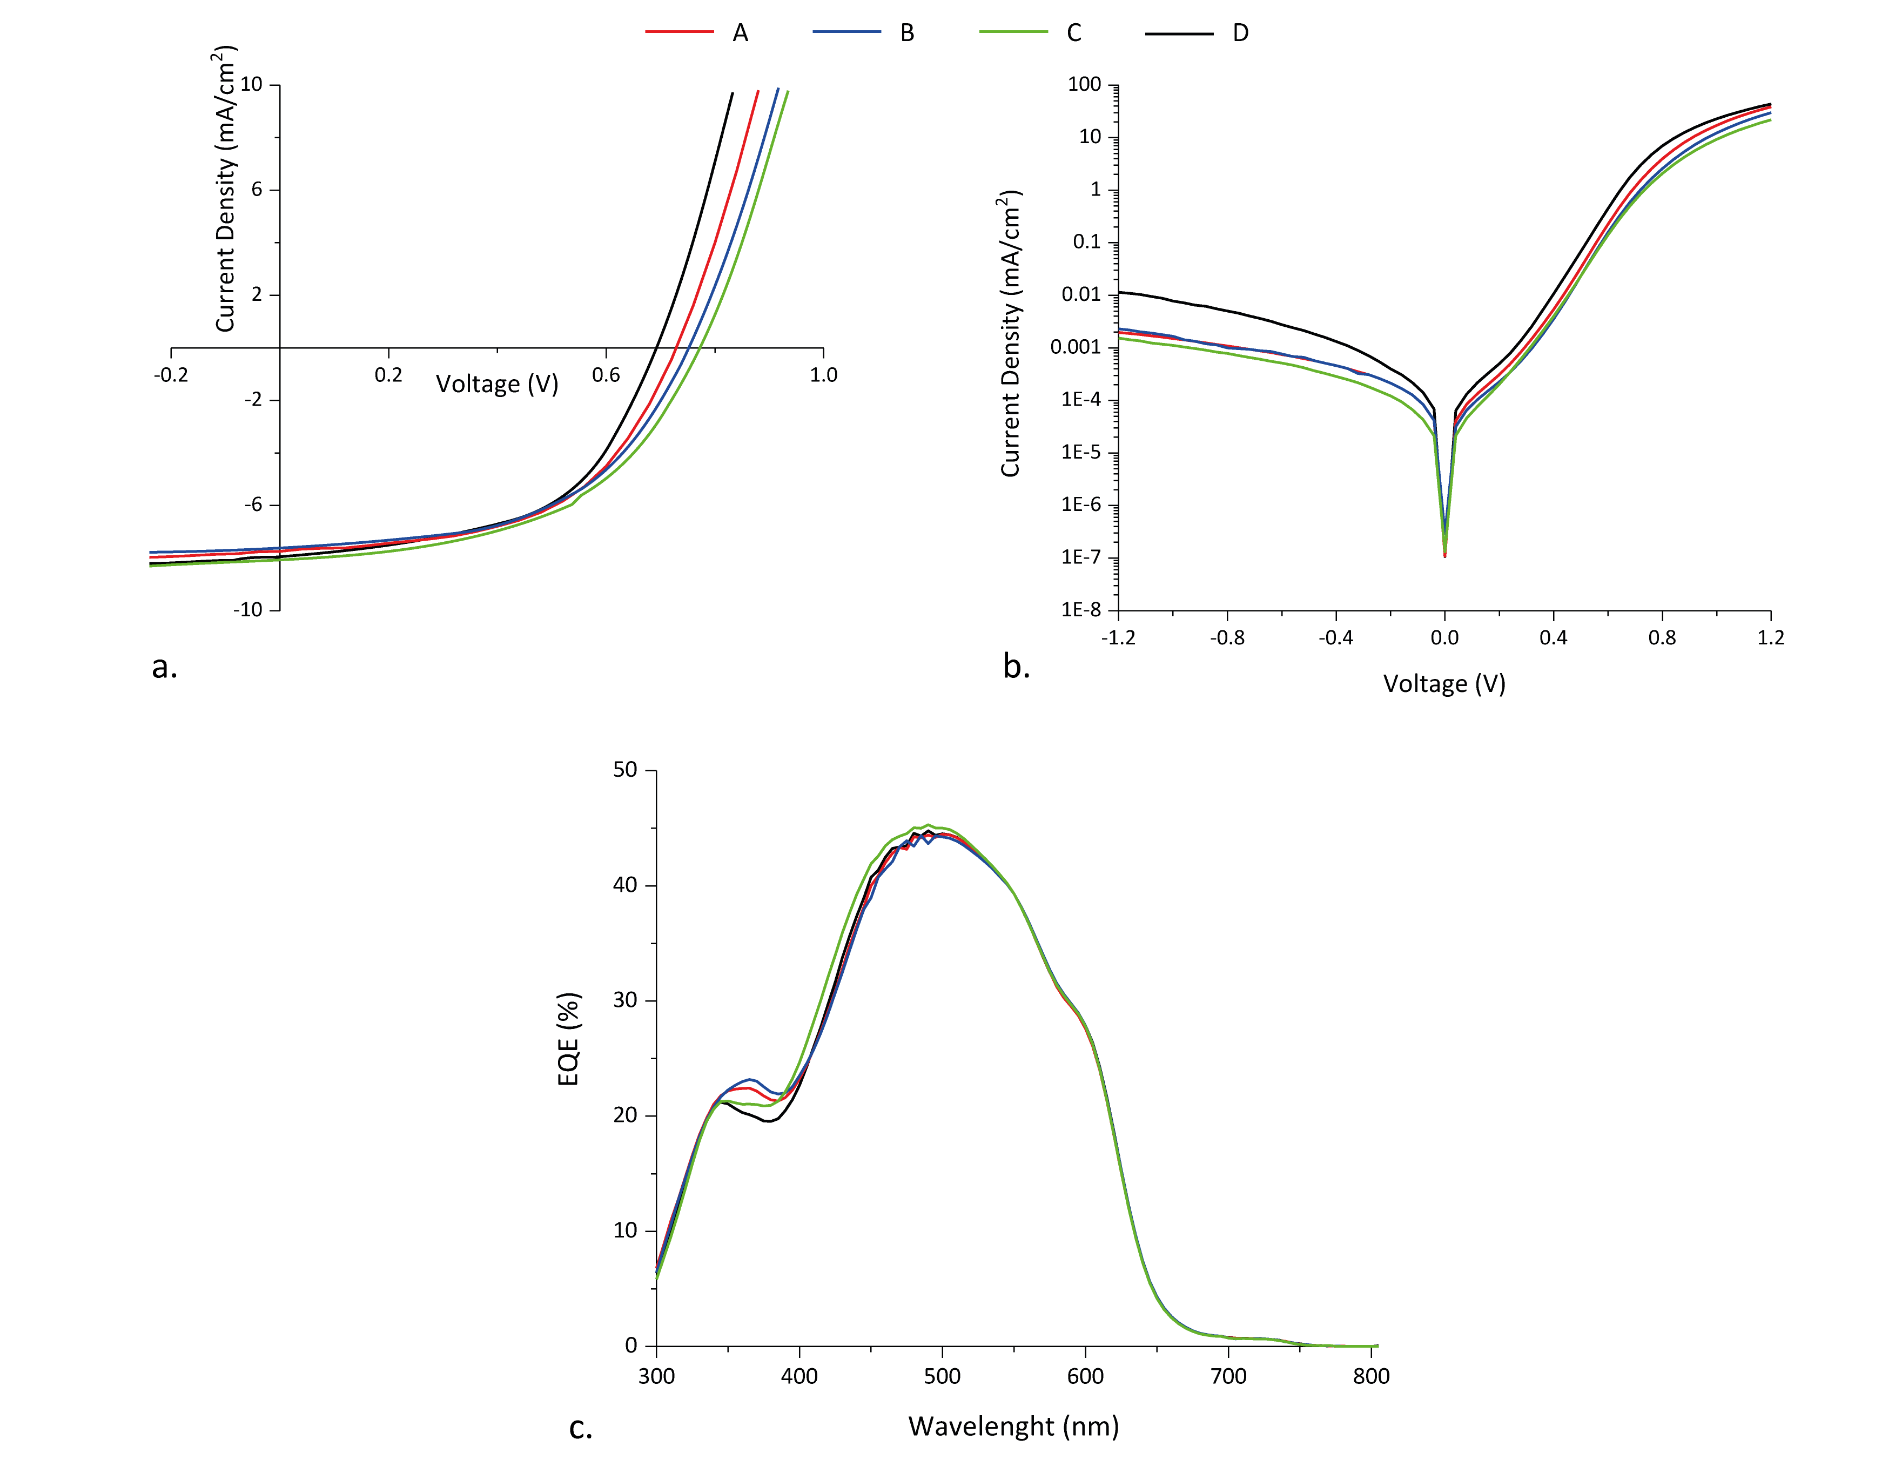
OPV
Sample | Measured parameter
 | V_{oc} | J_{sc} | FF | PCE | R_{sh} (kΩ) | R_{s} (Ω)
PEDOT:PSS | 0.73 | -8.16 | 0.58 | 3.41 | 17 | 380
A | 0.78 | -8.12 | 0.58 | 3.65 | 23 | 440
B | 0.81 | -8.04 | 0.56 | 3.59 | 23 | 490
C | 0.82 | -8.27 | 0.56 | 3.74 | 23 | 490
Notes:
OPV devices are shown first. From the J-V curves, it is clear that, while both FF and J_{sc} are fairly constant, there is a big improvement in V_{oc}. Indeed, when extracting the typical parameters, enhanced V_{oc} and R_{sh} are observed when the hybrids are used as HTL instead of PEDOT:PSS. This translates into higher PCE values. Further useful information can be extracted from J-V plots recorded under dark; the current in reverse bias gives an indication of the suitability of the interlayers as electron blocking behaviour. PEDOT:PSS by itself is already a good blocking layer, and the introduction of MoOx particles makes it even better, explaining the higher R_{sh} and consequently V_{oc}. MoOx likely act as a trap for any electron that may have made it through the energy barrier at the organic/hybrid interface, preventing it from recombining with holes reaching the anode.

Slide 30
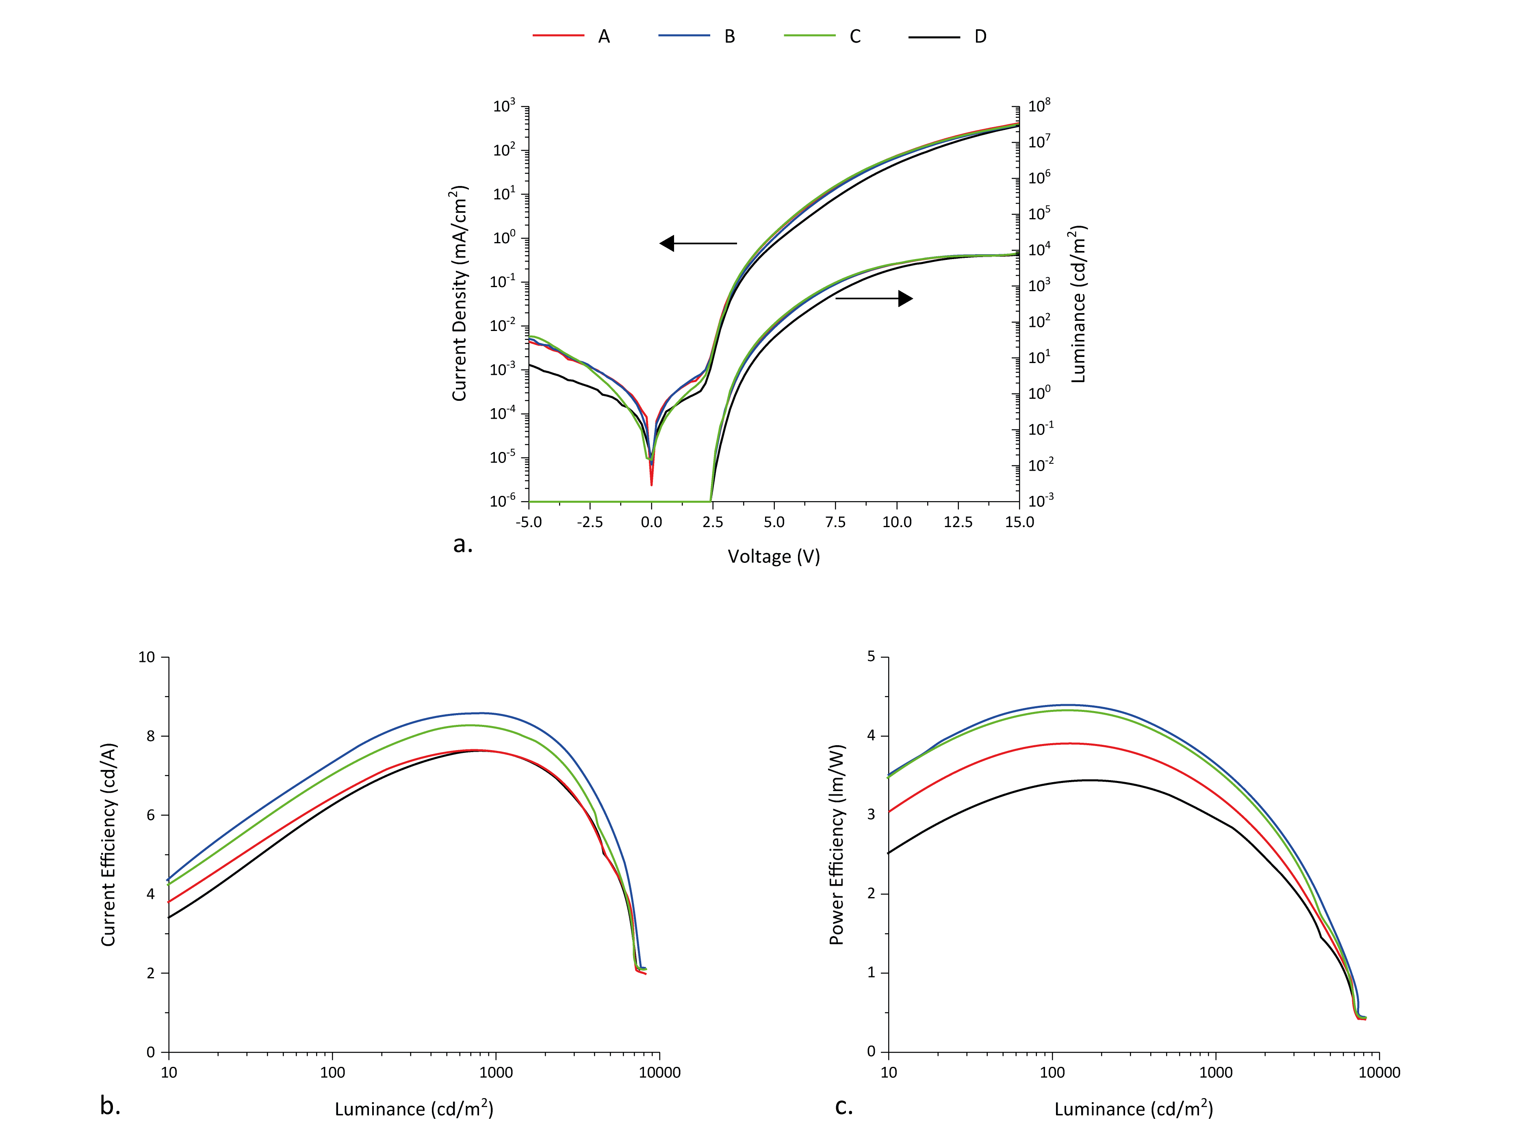
OLED
Sample | Max CE | V at max CE | PE at max CE | L at max CE | J at max CE
PEDOT:PSS | 5.57 | 6.2 | 2.80 | 1210 | 21.95
A | 5.89 | 5.6 | 3.30 | 1287 | 20.37
B | 6.13 | 5.6 | 3.41 | 1119 | 18.48
C | 6.03 | 5.5 | 3.45 | 1112 | 18.67

Slide 31
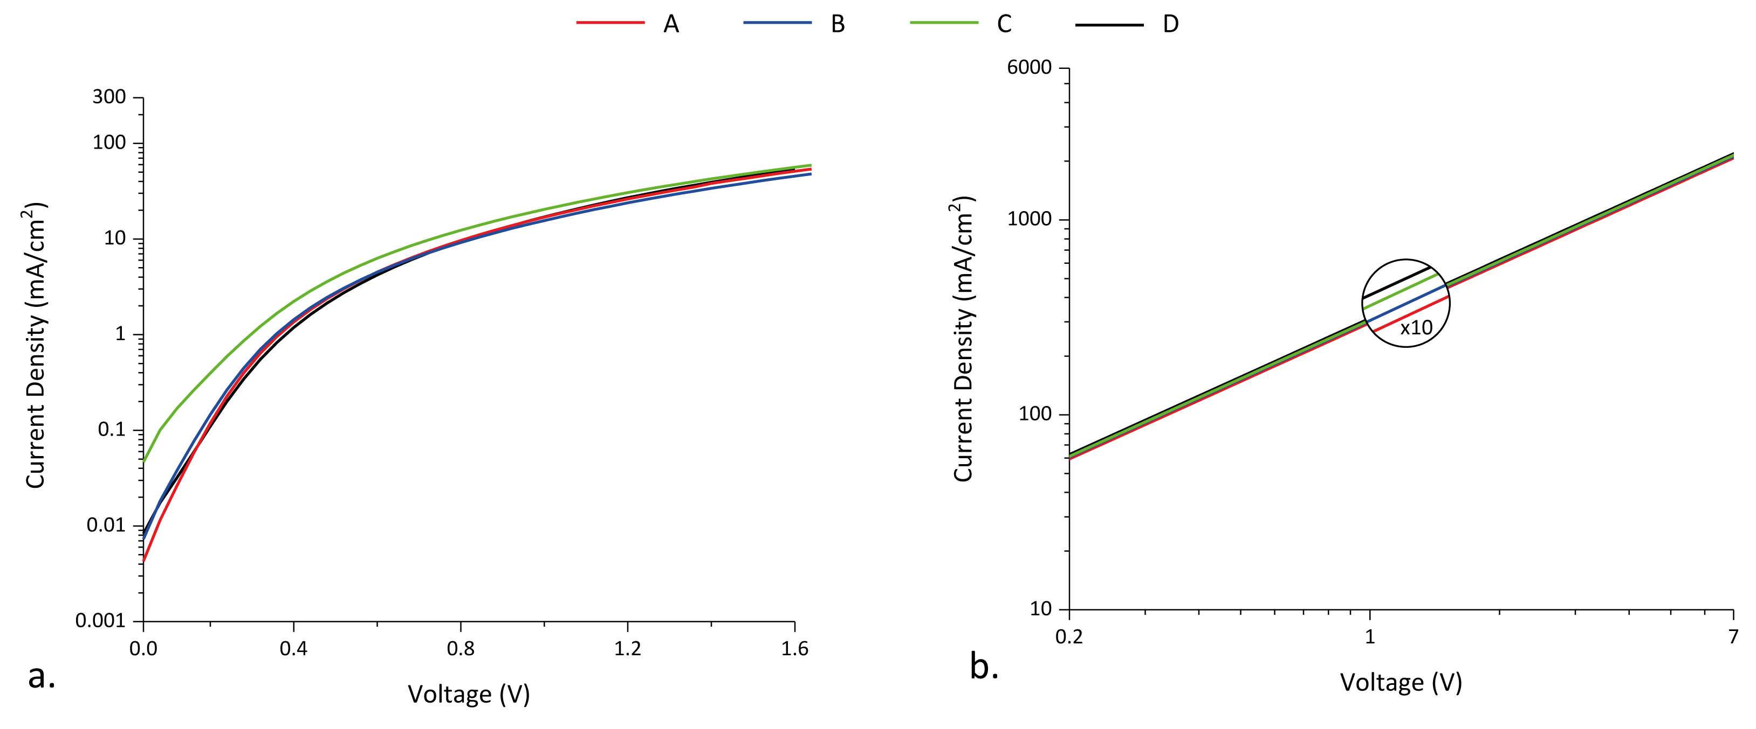
Injection

Slide 32
Conclusions
The properties of PEDOT:PSS can be tuned by incorporating MoO_{3-x}
- effectively fabricating an organic:inorganic hybrid;
Using our variation of the hydrogen bronze route, excellent dispersion of MoO_{3-x} particles in the organic matrix is achieved;
Tunability of the refractive index is also demonstrated;
Efficiency improvements are obtained in both OPV and OLED devices when simple PEDOT:PSS is substituted with the hybrids.
A study on the stability of devices incorporating the hybrid HTL would be the natural next step; also, variations in the thickness of the HTL could be explored to find a possible “sweet spot” to maximise the gain in EQE observed with Sample C.

Slide 33
Acknowledgements
Thanks to:
Luca Occhi and Dr Paul Stavrinou for their help with the optical measurements
Dr Claire Burgess for the TEM images and the EDX data
And to you all for your attention

